Slide 1
Introduction to E-Business for Microenterprises:
E-Commerce and Online Sales
Author partner: IDP European Consultants
MICRO 2 – Enhancing Digital Entrepreneurship of Micro Enterprises in Rural Areas in a Post Pandemic World
2022-1-IE01-KA220-VET-000088074

Slide 2
Objectives and Goals
At the end of this module, you will be able to:
E-COMMERCE
Understand the basics of e-commerce, including key concepts, terms and principles
Navigate the e-commerce landscape, form analysing opportunities to tips for a strategy
ONLINE STORE
Choose the ideal e-commerce platform for your business, also considering the differences between B2B and B2C operations
Make informed decisions about specific activities for an online store
ONLINE SALES
Operationalise your business from strategy and first decisions to online sales operations
Implement targeted strategies, such as CRM and data analytics, to optimise sales and conversions, effectively adapt to changing market, and expand your online presence

Slide 3
Index
UNIT 1: Introduction to E-Commerce
UNIT 2: Setting Up Your Online Store
UNIT 3: Scaling Up Your Online Sales
1.1 Understanding the Fundamentals of E-Commerce
3.1 Implementing a Visibility Strategy
1.2 Navigating the E-Commerce Landscape
1.3 Identifying Opportunities for E-Commerce
1.4 Developing Your Strategies
2.1 B2B vs B2C
2.2 E-Commerce Platform: How to Choose the Best One
2.3 Designing Your Online Store
2.4 Product and Services Listing and Captions
2.5 Payment and Shipping Solutions
2.6 Data Collection System and Review
3.2 The Function of Data Analytics and CRM
3.3 Adapting to Dynamic Market Conditions

Slide 4
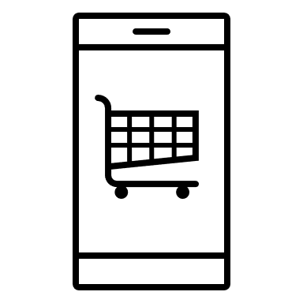
Unit 1: Introduction to E-Commerce
1.1 Understanding the Fundamentals of E-Commerce
“E-commerce can be defined generally as the sale or purchase of goods or services, whether between businesses, households, individuals or private organisations, through electronic transactions conducted via the internet or other computer-mediated (online communication) networks”
Source: Eurostat, Glossary: E-commerce (2023)
What is the e-commerce?
E-commerce, short for electronic commerce and also known as online commerce, refers to the process of buying or selling tangible products and services through online marketplaces. This dynamic process comprises commercial transactions with no need for physical contact. It operates across various market segments and using diverse smart devices: PCs, tablets, smartphones, etc.
Multiple parties are engaged in an exchange of:
Data
Currency
Product(s) or service(s)

Slide 5
Unit 1: Introduction to E-Commerce
1.2 Navigating the E-Commerce Landscape (1)
To navigate the e-commerce landscape effectively, let’s introduce the key terms and concepts for a comprehensive understanding of this dynamic process:
E-commerce Platform
The infrastructure for displaying goods for sale via an online shop. It is a website or an app and can be either by the seller itself (its own website or app) or a third-party digital marketplace (eBay, Amazon, etc.). The latter include social media marketplaces such as Facebook’s Marketplace, which allows the buying and selling directly on the social media.
Shopping Cart
A virtual cart on an online marketplace, often graphically placing in the top right-hand corner, where adding products and services to purchase. It represents the customers’ selection for their online shopping and can be reviewed, modified and confirmed during the check-out phase.
Product / Service Listing
The catalogue of products / services available, entered one by one and grouped by categories, sections, etc. It includes the most important information per product such as image(s), features description, price, tags and other elements, often with the possibility to search by filters. Reviews are often added to the seller’s description giving the end user’s point of view.

Slide 6
Unit 1: Introduction to E-Commerce
1.2 Navigating the E-Commerce Landscape (2)
Payment Gateway
A technology service for enabling online payments with an exchange of payment information between the customer, the merchant and the financial intermediary.
It involves encryption and authentication measures for the protection of sensitive financial information and the security of online transactions.
Shipping Solutions
The set of logistical services involved in the delivery and eventual return of products or services to customers.
These services include conditions, timing, costs, packaging, tracking and any options for shipping carriers (e.g., yourself or a third-party partner).
Market Segments
Distinct groups into which different operational approaches are categorised.
These represent different types of e-commerce depending on the identity of the seller and the target audience, as follows:
Business-to-Consumer (B2C)
Business-to-Business (B2B)
Business-to-Government (B2G)
Consumer-to-Consumer (C2C)
Consumer-to-Business (C2B)
… etc.

Slide 7
Unit 1: Introduction to E-Commerce
1.2 Navigating the E-Commerce Landscape (3)
Terms and Conditions
Usually abbreviated as T&C, they refer to the set of rules, regulations, and contractual agreements for the terms of service or product provision, as well as the rights and responsibilities of all parties involved.
This set establishes expectations, obligations, and limitations for both the supplier and the customer.
Covering key elements such as contract details, payment and pricing, delivery and return, liability and disclaimer, privacy policy, cancellation policy, intellectual property, and applicable law, T&C represent the legal foundation of the transaction, aiming to ensure clarity and legal binding.
Data Collection System and
Customer Relationship Management (CRM)
Data and stats are essential for monitoring, tracking and analysing the results and, consequently, for making data-driven decisions.
Within this framework, data analytics uses tools, software and procedures to gather customer data, behaviour analysis and purchase history. It serves for improving marketing and customer service. Collection of any data must be done in compliance with data protection policies and procedures.
This approach involving customer engagement, communication and data analysis refers to the CRM.

Slide 8
Unit 1: Introduction to E-Commerce
1.3 Identifying Opportunities for E-Commerce (1)
E-commerce (selling online) offers numerous advantages and opportunities for enterprises, representing their potential for entry, growth and success in the digital landscape – a new opportunity for business. These include:
Global Market Reach: Unlike physical shops, where customers are limited to their local area, through online commerce companies can sell products to customers all over the world. E-commerce therefore allows companies to expand their business and market, overcoming physical and geographical limitations and reaching global audience.
Flexibility and Accessibility: As before, physical shops generally remain open with limited hours. E-commerce, on the other hand, allows customers to purchase products and services wherever they are, through numerous devices and, above all, at any time. As a result, sellers (companies) are able to generate sales and profits 24/7, taking advantage of customers’ different schedules and time zones.
Cost-Efficiency: The costs for a digital presence, i.e. for starting and running an e-commerce, are usually lower than those for a physical shop. If not lower, the costs of an e-commerce are more scalable and lower in terms of opportunity cost.

Slide 9
Unit 1: Introduction to E-Commerce
1.3 Identifying Opportunities for E-Commerce (2)
Vocation for Data Analytics: E-commerce provides companies with a wealth of data about various aspect (e.g., consumer behaviour) that, once collected, analysed and processed through the right tools, enables data-driven decisions to steer business strategies towards sustained growth and competitiveness.
Personalisation and Targeted Marketing: Based on the above, consumer data enables companies to create marketing campaigns and activities (e.g. adv, pop-ups, etc.) tailored to a specific target group of consumers based on their preferences and behaviours. This has positive implications, from customer engagement to customer loyalty.
Adaptability and Management of Goods and Services: Again, the data collected provides useful information for possible diversification of the offer, to adapt it to new trends and customer demands. E-commerce facilitates adaptability, ensuring that companies remain relevant and competitive.
User Experience Enhancement: E-commerce amplifies the concept of user experience in customer relationship, employing activities like intuitive website design and customer service. This enhances the overall experience, facilitating quicker and more efficient progression to the customer retention stage.

Slide 10
Unit 1: Introduction to E-Commerce
1.4 Developing Your Strategies
These are the main steps to successfully enter the world of e-commerce and develop your own strategies:
Understanding Your Market Segment and Target Audience
Selecting the Appropriate E-Commerce Platform
Designing a User-Friendly Online Store
Uploading the Right Products or Services in the Right Way
Implementing Secure Payment and Shipping Solutions
Gathering Data and Reviews
SETTING UP YOUR ONLINE STORE
see unit 2
Leveraging Social Media and Online Marketing for Visibility
Implementing Data Analytics and Customer Relationship Management
Expanding Your Online Presence
Adapting to Dynamic Market Trends
Monitoring and Managing Your Strategy
SCALING UP YOUR ONLINE SALES
see unit 3

Slide 11
Unit 2: Setting Up Your Online Store
2.1 B2B vs B2C
Before embarking on any e-commerce activity, a company must select its target market segment and, consequently, its target audience. Regarding the market segment, these are the essential models from which a microenterprise – in our case – must choose for an effective online store setup:
Business-to-Business (B2B)
Concerns transactions between two businesses
Targets other businesses as final customers
Typically involves customised wholesale orders with previous negotiations
Business-to-Consumer (B2C)
Concerns transactions between businesses and individual consumers
Targets individual consumers as final customers
Typically involves single or smaller transactions and direct sales
This selection must take into account objectives and offerings of the individual company. The correct segment enables effective and efficient allocation of efforts and resources. Within the segment, audience targeting must then be carried out, selecting the buyer persona to whom the offer and consumer engagement activities should be addressed.

Slide 12
Unit 2: Setting Up Your Online Store
2.2 E-Commerce Platform: How to Choose the Best One (1)
Choosing an e-commerce platform is an important process that must be based on the characteristics and needs of your business. This process involves exploring the following selection criteria:
Needs: Assess your company’s unique needs and requirements
Compatibility: Match the features and functionality of the platform to your business needs and requirements
Ease of use: Choose a platform that aligns with the current and potential knowledge and skills of your team
Cost(s): Estimate and evaluate the start-up and running infrastructure costs and the opportunity cost
Scalability: Ensure the platform adds value to the business and, vice versa, the business adds value to the platform, so that both grow

Slide 13
Unit 2: Setting Up Your Online Store
2.2 E-Commerce Platform: How to Choose the Best One (2)
After assessing the previous criteria, there are essentially two alternative routes:
Building Your Own Online Store
Website Building Platforms: Platforms such as Shopify are ideal for companies with no skills and knowledge in website. These platforms allow you to build your online store via their tools and pre-sets
Customised Website: Unlike pre-set built websites, these are infrastructurally more complex but more flexible and with more functions and features. They are the option of companies with greater in-house expertise or who outsource the work to web design agencies
Selling on a Third-Party Platform
Online Marketplaces: Platforms like Etsy, eBay and Amazon offer visibility through access to a ready but competitive audience. They provide infrastructure support for managing payments, shipping, order tracking, returns, and product listing templates
Social Media Marketplaces: Platforms like Facebook Marketplace are suitable for businesses that focus on social media as direct selling channel or have limited inventory

Slide 14
Unit 2: Setting Up Your Online Store
2.3 Designing Your Online Store
Once you have opted for the right e-commerce platform, start designing your online store. To make your store fit well with your business idea, use customised elements to reflect your brand identity (Branding Consistency).
Other key features of a well-designed online store are:
Accessible and Intuitive Interface: Create a user-friendly design for effective navigation
Mobile-Friendly: As online commerce is going mobile (m-commerce), adapt and optimise content and payments for various devices, especially mobile ones
Quality Orientation: Present your services and products with HQ images and detailed captions
Search Functionality: Implement a search tool to easily navigate the store and locate services and products
UX Tools: Include tools and features such as a customer review form and ad hoc products recommendations

Slide 15
Unit 2: Setting Up Your Online Store
2.4 Product and Services Listing and Captions (1)
In a well-designed online store, the next step for an effective e-commerce strategy involves an effective product (i.e., products or services) listing with the addition of optimised image and description.
Whether you sell tangible products or digital products / services and after choosing which products to sell, the three basic elements to add those products to your online store are:
Title and Description
When crafting product listing, utilise concise title and a comprehensive description that goes beyond listing features, emphasising how the product brings benefits to customers (Benefits Over Features)
Highlight unique advantages over competitors (Unique Selling Proposition)
Anticipate consumer expectations and questions, understanding your target audience
Craft a consumer-oriented call-to-action to engage and convert, prompting them to envision using your products
Incorporate keywords for search engine optimisation (SEO)

Slide 16
Unit 2: Setting Up Your Online Store
2.4 Product and Services Listing and Captions (2)
Photos or Visual Elements
Within the media section of your product page, upload various visual elements such as photos, videos, photo an video series, or cut and 3d models. They enhance the tangible presentation of your product through additional visual details.
Maintain authenticity by ensuring that visual elements accurately and professionally represent the product (Consistency).
Opt for clear, HQ and captivating elements to showcase your product well (High-Quality Product Display).
Price
When deciding on the selling price of your product, consider the per-product cost, overall logistics cost, and factors influencing discounts and margins.
Here are three advices:
Display clear prices for all product compositions, such as single product vs duo-pack (Pricing Transparency)
Avoid underestimating your product; a lower price does not necessarily lead to increased sales. Consumers often use the price as a quick gauge for quality, influencing their decisions accordingly
Generate a sense of urgency in consumers through time-sensitive promotions (Limited-Time Offers)

Slide 17
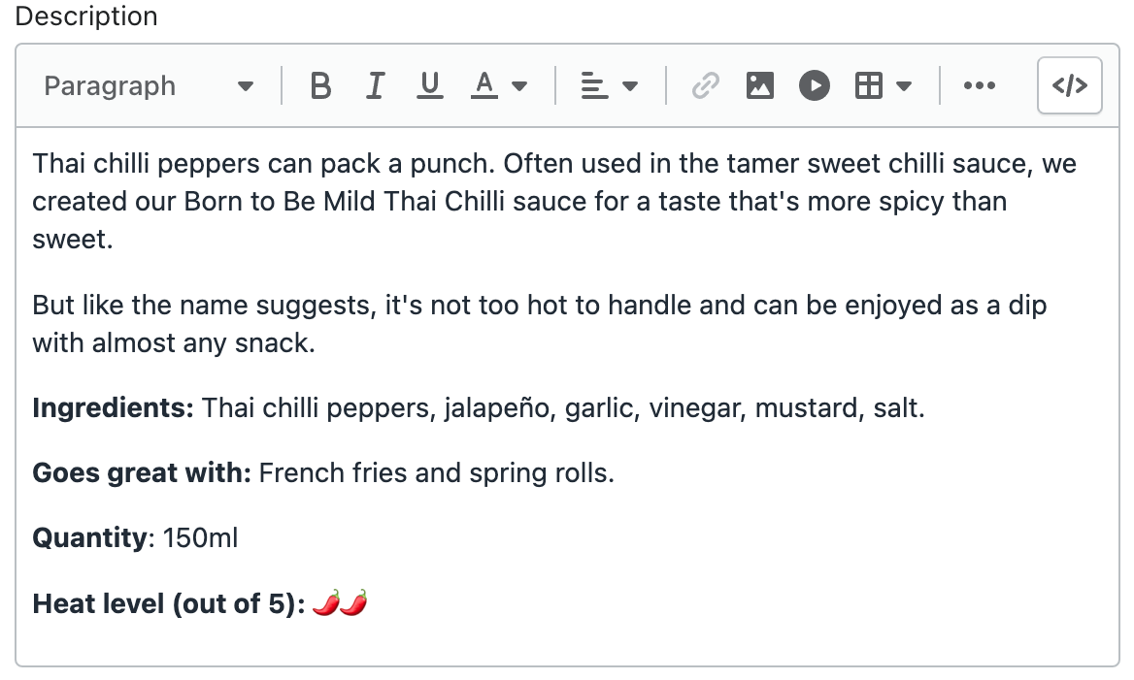
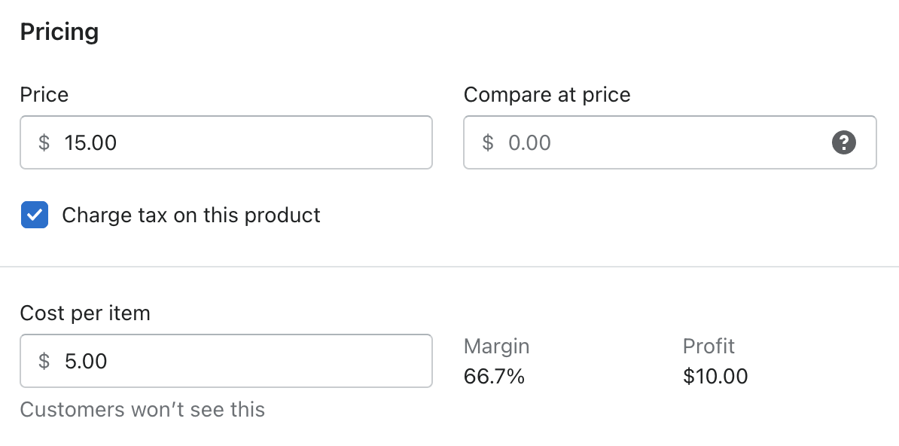
Unit 2: Setting Up Your Online Store
2.4 Product and Services Listing and Captions (3)
Directly from the Shopify dashboard for product listing, let’s observe an example of title, description, image and price.
Title: Born to be Mild Thai Chilli
Source: Shopify, How to Start an Online Store in 2023 (Step-by-Step Guide)

Slide 18
Unit 2: Setting Up Your Online Store
2.5 Payment and Shipping Solutions (1)
Once the products are listed, it is time to ensure smooth transactions and deliveries.
On the payment side, it is necessary to integrate reliable payment gateways for secure transactions, and also ensuring different payment options to meet customers’ needs and preferences - as many as possible - including:
Debit, Credit and Pre-Paid Cards
Example: Payments circuits such as Visa, Mastercard
Payment Platforms and Redirects
Example: PayPal
Mobile Wallets and E-Wallets
Example: One-click payment tools like Apple Pay, Google Pay and Skrill
Buy Now, Pay Later (BNLP)
Example: Instalment payment system like Klarna
Cash on Delivery (COD)
Example: Payment system on product delivery
Innovative Checkout Options
Example: Order online and pay in-store
Gift Cards and Vouchers
Example: Coupon and voucher redemption system to replace or supplement the currency
Direct Bank Transfer
Example: Traditional option for those who prefer it
Innovative Payments
Example: Payment with cryptocurrencies such as Bitcoin for those who prefer to pay with innovative methods

Slide 19
Unit 2: Setting Up Your Online Store
2.5 Payment and Shipping Solutions (2)
On the other side (shipping solutions) there are essentially two alternative (or complementary) solutions to fulfil orders:
Your Internal Logistic
Third-Party Logistic Partner(s)
In both scenarios, careful consideration of the following shipping options / variables, is important to shaping your logistics offering from a customer service perspective:
Packaging Options: Material choices based on product protection and marketing associated with its presentation
Shipping Costs: Introduction of various plans-based time, distance, size, and subscription vs one-time purchase
Shipping Time: Presentation of a timeline based on product availability, warehouse location, distances, and activities involved in the outbound logistics process
Shipping Track System: Preparation of a system for monitoring shipments from order processing to delivery
Shipping Policies: Introduction of return and refund options for enhanced customer service
Shipping Availability: Potential inclusion of expanded zones tailored to your target market and audience

Slide 20
Unit 2: Setting Up Your Online Store
2.6 Data Collection System and Review
In every aspect of your online store, from customer interactions to logistic, having a robust data collection system is essential. This system captures valuable information such as: contact information, email, search and purchase stats, time spent on product descriptions, shipment details, etc.
It is crucial to implement this while adhering to data protection regulations – ensuring GDPR compliance - and with the ultimate goal of utilising the collected data as valuable resources for data analysis and, consequently, for insightful data-driven decisions.
From data to direct information…
Besides the data collected from consumers, as mentioned earlier, it is recommended to actively gather direct information through testimonials and reviews. Therefore, incorporate into your strategy and as a service of your online store a dedicated review section, and consider sending emails to request feedback as a follow-up from the customer for each purchased item.

Slide 21
Unit 3: Scaling Up Your Online Store
3.1 Implementing a Visibility Strategy (1)
From setting up an online store to maximising sales… what happens after launching your online store?
Now it is the turn to operationalise the business, by attracting potential customers and with the aim to carry out successful online sales operations.
Transitioning from the setup phase to operationalisation means came across and overcome the following bridge:
The implementation of a visibility strategy
In terms of e-commerce and online, a visibility strategy is outlined in the following key activities:
Leveraging Social Media: Harness the power of social media platforms for enhanced visibility. Strategic use of channels like Facebook, Instagram, and also WhatsApp can broaden your audience reach (and management)

Slide 22
Unit 3: Scaling Up Your Online Store
3.1 Implementing a Visibility Strategy (2)
Online Marketing Tactics: Explore effective online marketing tactics to boost visibility. From SEO strategies to targeted advertisements, tailor your approach to your business and customers’ needs
Attracting Potential Customers: Implement strategies to attract potential customers. Whether through promotions, engaging content, or influencer collaborations, draw attention to your products or services
Establishing Online Presence: Strengthen your online presence through consistent branding and messaging. Create and maintain a cohesive brand identity that matches and resonates with your target audience
As a corollary to the visibility strategy that generates contacts and potential customers, consider implementing additional strategies that guide the customers in their customer journey – from the contact phase to loyalty, through the purchase of goods and services, and consequently, profit for the business.

Slide 23
Unit 3: Scaling Up Your Online Store
3.2 The Function of Data Analytics and CRM
These additional strategies within the customer journey refer to:
Data Analytics
Harness insights from customer behaviour, preferences and trends
Optimise website performance based on data-driven analysis
Fine-tune marketing strategies for maximum impact
Example: Utilising Google Analytics to track customer behaviour on the website, identifying peak visit times and popular product pages for targeted promotions
Customer Relationship Management (CRM)
Build and strengthen relationships with customers at every touchpoint
Implement personalised communication campaigns
Utilise customer data for effective problem resolution and improved satisfaction
Example: Setting up automated follow-up emails for customers who abandoned their shopping carts, providing them with incentives to complete their purchase and enhancing conversion rates

Slide 24
Unit 3: Scaling Up Your Online Store
3.3 Adapting to Dynamic Market Conditions
In monitoring and managing your e-commerce strategy, you must be ready to adapt to the changing and evolving dynamics of the market. Here are three tips to ‘stay on top of things’:
Stay Agile
Regularly assess market trends, consumer preferences, and competition
Example: Swiftly adjusting product offerings or promotional strategies based on real-time market data, ensuring relevance and competitiveness
Anticipate Changes
Proactively identify potential shifts in the market landscape
Example: Monitoring emerging trends and consumer sentiments to predict shifts, allowing timely adjustments to marketing and product strategies
Flexibility in Operations
Design strategies that can flexibly adapt to unforeseen market changes
Example: Having contingency plans for supply chain disruptions or sudden shifts in consumer behaviour, ensuring resilience and adaptability

Slide 25
Summing Up
UNIT 1
Key Concepts: E-commerce platform, shopping cart, products and services listing, payment gateway, shipping solutions, market segments, terms and conditions, data analysis, CRM
Opportunities: Global market reach, flexibility, cost-efficiency, data analytics advantages, personalised marketing, adaptability, enhanced user experience
UNIT 2
E-Commerce Platform Selection: Choosing the right platform involves assessing needs, compatibility, ease of use, costs, and scalability. Options include building a custom website or selling on third-party platforms
Store Design and Product Listing: Designing a user-friendly online store involves considerations like accessible interfaces and mobile-friendliness. Effective product listing includes optimized titles, images, and prices
UNIT 3
Visibility Strategy: Implementing a visibility strategy involves leveraging social media, employing online marketing tactics, attracting potential customers, and establishing a strong online presence
Data Analytics and CRM: Utilizing data analytics helps in optimizing website performance and fine-tuning marketing strategies. Customer Relationship Management (CRM) focuses on building and strengthening relationships with customers
Adapting to Market Conditions: Being agile, anticipating changes, and maintaining flexibility in operations are essential strategies for adapting to the dynamic nature of the e-commerce market

Slide 26
Self-Assessment Questions
What is e-commerce, as defined by Eurostat? | Which of the following represents a logistical service in e-commerce? | What does B2B stand for in the context of e-commerce? | What is a crucial factor when designing an online store for effective navigation? | How does data analytics contribute to e-commerce strategy?
An exchange of goods and services between businesses The sale or purchase of products through electronic transactions conducted online The process of negotiating contracts between private organisations A digital marketplace for social media interactions | E-commerce Platform Shopping Cart Payment Gateways Shipping Solutions | Business-to-Consumer Business-to-Business Buyer-to-Buyer Business-to-Buyer | Accessibility and Intuitive Interface Complex interface to engage users Limited adaptability for various devices Exclusive focus on desktop users | By processing payments securely By tracking customer behaviour, preferences, and trends for data-driven decisions By managing shipping and logistics efficiently By creating visually appealing product listings

Slide 27
Thank you!
Continue your training path at https://www.digitalmicro2.eu/

